Slide 1
Segmentation
P2C and Jungle datasets

Slide 2
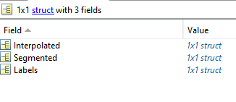
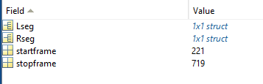

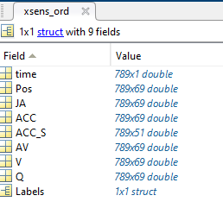
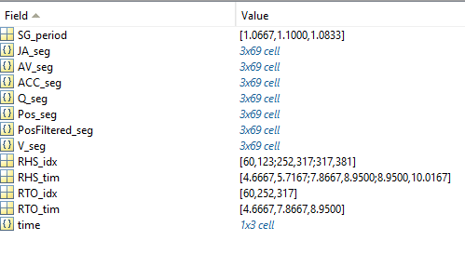
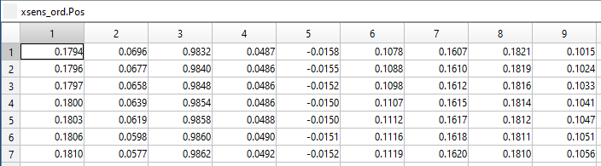
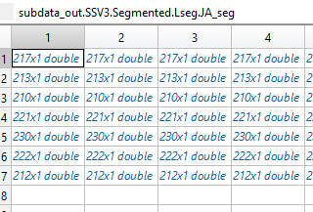
Data segmentation (walking)
Code source: \\fs2\RTO\P2C\Code\Xsens feature extraction
Data source: \\fs2\RTO\P2C\P2C_Database_Segmented - Database paper version
\code_versions_logging.txt
File with a list of the changes from one version to the other of the segmentation code
Code source\2. Gait cycle segmentation\main_STARS_Inpatient_Step03_XSens_GaitSegmentation_v2
Generating a struct with the segmented data over each identified gait cycle
_Extracted.mat
_Segmented.mat

Slide 3
Brief code description (code lines)
Enter folder architecture by condition, participant, and task and trial (1-94)
It takes all the frames contained in the signal (95-114)
Check for axis inversion, by displaying AV left and right shank, y axis. If the user agrees to invert axes, all x and y ACC and AV are changing sign (129-145)
-EDIT: the lines actually inverting the signs are now commented. The user can write in a separate file if the inversion should be needed and eventually do separately-
High-pass filter to remove the drift from the position (order=5, cutoff=1) + display the filtered and non-filtered signal (145-160)
Detects heel strike using x left and right x foot Pos (168-177)
If the gait tasks are 2MWT or 6MWT, a plot with only the right x position with the automatic detected peaks is provided (177-189)
If the gait tasks are 2MWT or 6MWT, it is asked if the automatic segmentation on the right side is correct. Two options are provided, ‘delete some peaks’ and ‘add some peaks’, and in both cases it is asked the user to identify a point on the vertical axis that will be used as filter for the peaks. In case the option ‘delete some peaks’ will be identified, the automatic detected peaks will be further filtered removing those below the y level indicated by the user (196-207) In case the option ‘add some peaks’ is selected, all the peaks are detected again and then filtered based on the y level indicated by the user (209-220)
If the gait tasks are 2MWT or 6MWT, the final peaks are displayed once again to the user. If the user is not satisfied, there is no way to further modify the peaks, so the user should stop the code and repeat. If the user agrees, a click on the figure should allow the code to proceed (228-236)
If the gait tasks are 2MWT or 6MWT, the steps 6-7-8 are repeated for the left side (236-302)

Slide 4
Brief code description (code lines) – pt2
If the gait tasks is a 10MWT, the automatic segmentation is displayed in one unique figure overlapping the left and right side (304-320)
If the gait tasks is a 10MWT, the user is asked to confirm of modify the automatic peak detection on the right side. Three options are provided, ‘delete peaks’, ‘add peaks’, and ‘select all peaks again’ In case ‘select all peaks again’ is selected, the user is asked to detect all the peaks on the right side again, in order (321-337) In case ‘add peaks’ is selected, the user is asked to add peaks the automatic detection missed; a specific order is not required (338-351) In case ‘delete peaks’ is detected, the user can detect some peaks automatically selected to be deleted. The code will automatically detect the closest peaks to the position of the user, and delete them (352-369)
If the gait tasks is a 10MWT, the steps 6-7-8 are repeated for the left side (370-420)
If the gait tasks is a 10MWT, the final peaks are displayed once again to the user. If the user is not satisfied, there is no way to further modify the peaks, so the user should stop the code and repeat. If the user agrees, a click on the figure should allow the code to proceed (421-447)
Toe off detection using the heel strikes and the x left and right foot Pos (450-440)
Segmentation and interpolation of all the available data (464-496)
Saving and plotting (499-579)

Slide 5
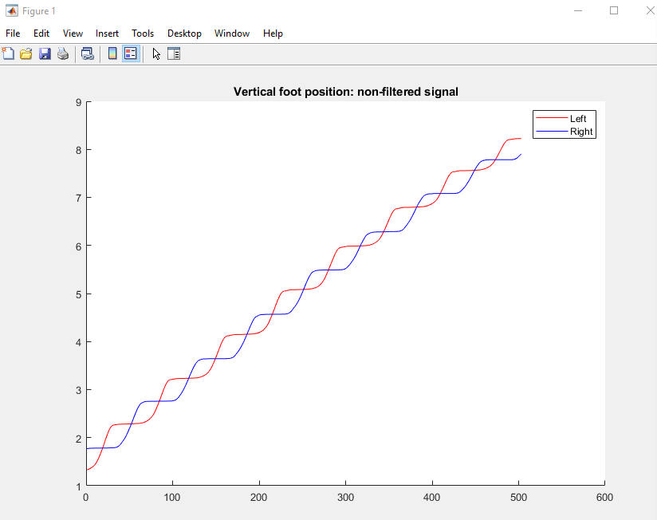
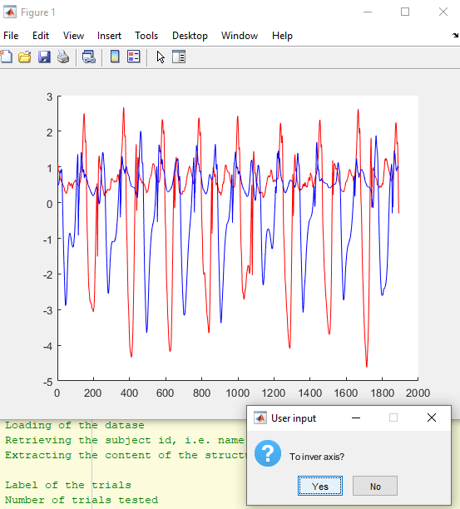
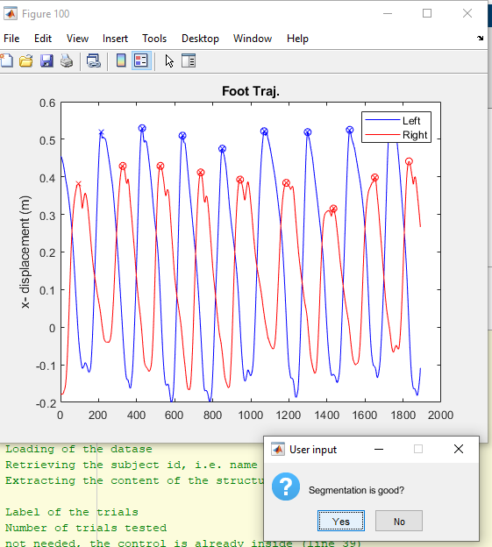
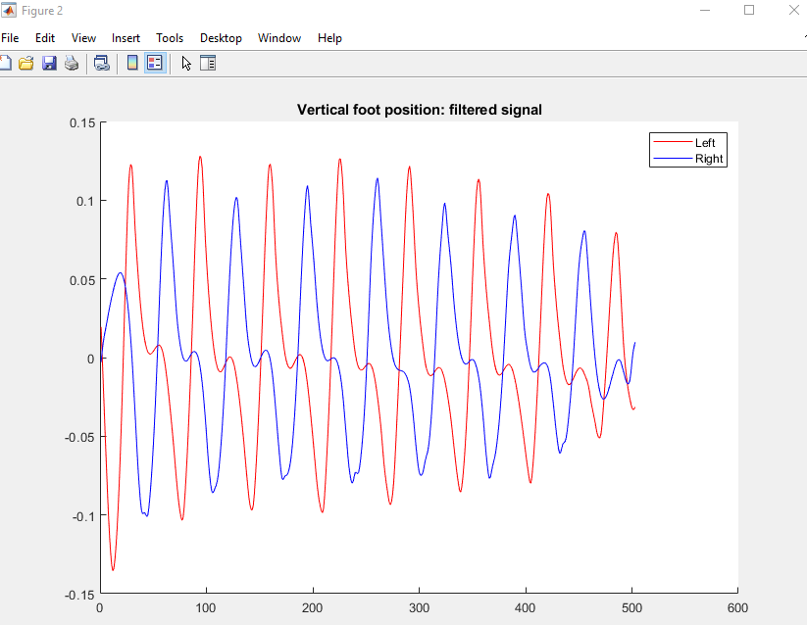
Manual checks of the code
Filtering
(variable plot_verbosity=0 can turn off these plots)
*Attention: this part has been updated, read the code description to understand how to deal with it (points 7 and 11)
Peak detection*
(manual peak detection required in case the segmentation is not considered good)
Axis orientation

Slide 6
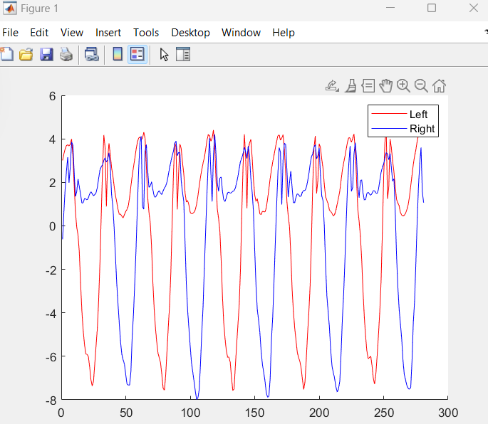
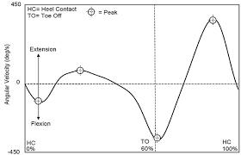
Axis orientation
In this case, you need to ask the code to invert the axis
This an internet example of one stride, a typical shape of a healthy correct AV of the knee
This an example from P2C data of multiple strides, a shape of a healthy participant, AV of the shank, with wrong sign

